Slide 1
NETWORK SECURITY
(GROUP-28)
IIT2018105 (BINDU)
IIT2018118 (AYUSHI GUPTA)
IIT2018120 (SANJANA)
IIT2018138 (T S CHINMAY)
IIT2018147 (NILAANG VASAVA)

Slide 2
DIFFERENCE BETWEEN ROUTER AND GATEWAYS
ROUTER
GATEWAY
PRIMARY FUNCTION | It is a hardware device that receives, analyses and transmits the data packets to other networks. | Gateway is essentially a device used to communicate between networks which have a different set of protocols and are responsible for converting one protocol to another.
TRAFFIC REGULATION | Routers regulate traffic between similar networks | Gateways regulate traffic between dissimilar networks

Slide 3
ROUTER
GATEWAYS
HOSTED ON | Dedicated appliance I.e router hardware | Dedicated/virtual appliance or physical server
DYNAMIC ROUTING | Dynamic Routing is supported. | Dynamic Routing is not supported.
WORKING PRINCIPLE | Routing information is achieved for different networks and destination address is the basis for routine traffic | Differentiating that what is inside and what is outside network
OSI LAYER | It works on OSI layer 3 and 4. | It works upto layer 5

Slide 4
GATEWAY VS ROUTER:WHEN TO CHOOSE WHICH?
Suppose there are two network and computer A belongs to network 1 while computer B belongs to network 2 and they want to communicate with each for the communication ,we will use gateway while for same network communication we would use router.

Slide 5
NEED FOR GATEWAYS
A gateway is a node (router) in a computer network, a key stopping point for data on its way to or from other networks. Through gateways, we are able to communicate and send data back and forth. The Internet wouldn't be any use to us without gateways (as well as a lot of other hardware and software).

Slide 6
NEED FOR ROUTING
Routers are responsible for receiving, analysing, and forwarding data packets among the connected computer networks. When a data packet arrives, the router inspects the destination address, consults its routing tables to decide the optimal route and then transfers the packet along this route.

Slide 7
Question 17:
Virus , worm, threat, advanced persistent threat, bomb, adware, malware, vulnerability, zero day vulnerability, penetration testing, zero-day attack, Shoulder surfing,
keylogger, spyware, Trojan, spear phishing, Social engineering attack, ransomware, rootkit.

Slide 8
VIRUS
A virus is a computer code or program, which is capable of affecting your computer data badly by corrupting or destroying them.Computer virus has the tendency to make its duplicate copies at a swift pace, and also spread it across every folder and damage the data of your computer system.A computer virus is actually a malicious software program or "malware" that, when infecting your system, replicates itself by modifying other computer programs and inserting its own code.Ways in which a virus can affect our computer system are-by downloading files from the internet,during the removable of media or drives,through pen drive,through e-mail attachments,through unpatched software & services,through unprotected or poor administrator passwords.

Slide 9
WORM
A computer worm is a stand-alone computer malware programme that replicates itself in order to spread to other computers. It often uses a computer network to spread, relying on security failures on the target computer to access it.Worms can be transmitted via software vulnerabilities. Or computer worms could arrive as attachments in spam emails or instant messages (IMs). Once opened, these files could provide a link to a malicious website or automatically download the computer worm. Once it’s installed, the worm silently goes to work and infects the machine without the user’s knowledge. Worms can modify and delete files, and they can even inject additional malicious software onto a computer. Sometimes a computer worm’s purpose is only to make copies of itself over and over — depleting system resources, such as hard drive space or bandwidth, by overloading a shared network. In addition to wreaking havoc on a computer’s resources, worms can also steal data, install a backdoor, and allow a hacker to gain control over a computer and its system settings.

Slide 10
THREAT
In the field of network security, a threat is a potential negative action or event that facilitates a vulnerability that results in an unwanted impact on a computer system or application in terms of network.

Slide 11
ADVANCED PERSISTENT THREAT
An advanced persistent threat is an attack in which unauthorised users gain access to a system or network and remain there for an extended period of time without being detected. Instead, the aim of advanced persistent threats is most often data theft.Advanced persistent threats typically have several phases, including hacking the network, avoiding detection, constructing an attack plan, and mapping company data to identify where the desired data is most readily available, collecting sensitive company data, and data leakage .

Slide 12
ADWARE
Adware refers to a type of malware that displays unwanted advertisements on your computer or device. Adware is commonly activated unknowingly when users are trying to install legitimate applications that adware is bundled with.While sometimes, adware can be safe and on other time it is not, some pop-up windows intend to not only display advertisements but also collect data and information in order to target you with customised adverts. In these cases, adware can direct you to malicious websites and infected pages through various advert links, putting you at risk of computer viruses.

Slide 13
MALWARE
Malware is the collective name of a number of malicious software variants, including viruses , ransomware, and spyware. In the case of malicious software, malware typically consists of code developed by cyber attackers, designed to cause extensive damage to data and systems, or to gain unauthorised access to the network. Malware is typically delivered via e-mail in the form of a link or file. Malware delivers its payload in a number of different ways. From demanding a ransom to stealing sensitive personal data, cybercriminals are becoming more and more sophisticated in their methods.

Slide 14
VULNERABILITY
In cyber security, a vulnerability is a weakness which can be exploited by a cyber attack to gain unauthorized access to perform unauthorized actions on a computer system. Vulnerabilities can allow attackers to run code, access a system's memory, install malware, and steal, destroy or modify sensitive data.
To exploit a vulnerability an attacker must be able to connect to the computer system.

Slide 15
ZERO-DAY VULNERABILITY
A zero-day vulnerability is a vulnerability in a system or device that has been disclosed but is not yet patched. An exploit that attacks a zero-day vulnerability is called a zero-day exploit. Because they were discovered before security researchers and software developers became aware of them—and before they can issue a patch—zero-day vulnerabilities pose a higher risk to users for the following reasons:
Cybercriminals race to exploit these vulnerabilities to cash in on their schemes
Vulnerable systems are exposed until a patch is issued by the vendor.
Zero-day vulnerabilities are typically involved in targeted attacks; however, many campaigns still use old vulnerabilities.

Slide 16
PENETRATION TESTING
Penetration testing, also called pen testing or ethical hacking, is the practice of testing a computer system, network or web application to find security vulnerabilities that an attacker could exploit. Penetration testing can be automated with software applications or performed manually. Either way, the process involves gathering information about the target before the test, identifying possible entry points, attempting to break in -- either virtually or for real -- and reporting back the findings.The main objective of penetration testing is to identify security weaknesses. Penetration testing can also be used to test an organization's security policy, its adherence to compliance requirements, its employees' security awareness and the organization's ability to identify and respond to security incidents.

Slide 17
ZERO-DAY ATTACK
If a hacker manages to exploit the vulnerability before software developers can find a fix, that exploit becomes known as a zero day attack.Zero day vulnerabilities can take almost any form, because they can manifest as any type of broader software vulnerability.This makes zero day vulnerabilities difficult to proactively find—which in some ways is good news, because it also means hackers will have a hard time finding them. But it also means it’s difficult to guard against these vulnerabilities effectively.

Slide 18
SHOULDER SURFING
In computer security, shoulder surfing is a type of social engineering technique used to obtain information such as personal identification numbers (PINs), passwords and other confidential data by looking over the victim's shoulder, either from keystrokes on a device or sensitive information being spoken and heard, also known as eavesdropping.

Slide 19
KEYLOGGER
A keylogger is a program that records the keystrokes on a computer. It does this by monitoring a user's input and keeping a log of all keys that are pressed. The log may be saved to a file or even sent to another machine over a network or the Internet. Keylogger programs are often deemed spyware because they usually run without the user knowing it. They can be maliciously installed by hackers to spy on what a user is typing. By examining the keylog data, it may be possible to find private information such as a username and password combination. Therefore, keyloggers can be a significant security risk if they are unknowingly installed on a computer.

Slide 20
SPYWARE
Spyware is unwanted software that infiltrates your computing device, stealing your internet usage data and sensitive information. Spyware is classified as a type of malware — malicious software designed to gain access to or damage your computer, often without your knowledge. Spyware gathers your personal information and relays it to advertisers, data firms, or external users.Spyware is used for many purposes. Usually it aims to track and sell your internet usage data, capture your credit card or bank account information, or steal your personal identity. How? Spyware monitors your internet activity, tracking your login and password information, and spying on your sensitive information.Some types of spyware can install additional software and change the settings on your device, so it’s important to use secure passwords and keep your devices updated.

Slide 21
TROJAN
A Trojan horse, or Trojan, is a type of malicious code or software that looks legitimate but can take control of your computer. A Trojan is designed to damage, disrupt, steal, or in general inflict some other harmful action on your data or network.A Trojan acts like a bona fide application or file to trick you. It seeks to deceive you into loading and executing the malware on your device. Once installed, a Trojan can perform the action it was designed for.A Trojan is sometimes called a Trojan virus or a Trojan horse virus, but that’s a misnomer. Viruses can execute and replicate themselves. A Trojan cannot. A user has to execute Trojans. Even so, Trojan malware and Trojan virus are often used interchangeably.

Slide 22
SPEAR PHISHING
Spear phishing is an email or electronic communications scam aimed at a specific individual , organisation or business. Although it is often intended to steal data for malicious purposes, cyber criminals may also intend to instal malware on a targeted user's computer. This is how it works: An email arrives, apparently from a trustworthy source, but instead it leads the unknowing recipient to a bogus website full of malware. These emails often use clever tactics to bring victims to their attention. For example, the FBI has warned of spear phishing scams where the emails appeared to be from the National Center for Missing and Exploited Children.

Slide 23
SOCIAL ENGINEERING ATTACK
Social engineering is the term used for awide range of malicious activities carried out through human interactions. It uses psychological manipulation to trick users into making security mistakes or delivering sensitive information.Social engineering attacks are taking place in one or more steps. In the first place, the perpetrator investigates the intended victim in order to gather the necessary background information, such as potential entry points and weak security protocols, needed to proceed with the attack. The attacker then moves to gain the victim's trust and to provide incentives for subsequent actions that break security practises, such as revealing sensitive information.

Slide 24
RANSOMWARE
Ransomware is a kind of malicious software ( malware) that threatens to publish or block data or computer system access, usually by encrypting it, until the victim pays the attacker a ransom fee.There are a number of vectors ransomware can take to access a computer. One of the most common delivery systems is phishing spam — attachments that come to the victim in an email, masquerading as a file they should trust. Once they're downloaded and opened, they can take over the victim's computer, especially if they have built-in social engineering tools that trick users into allowing administrative access.

Slide 25
ROOTKIT
A rootkit is a malicious software that allows an unauthorised user privileged access to a computer and its software's restricted areas.This software remain hidden in the computer and allow the attacker remote access to the computer.Rootkit installation can be automated, or an attacker can install it after having obtained root or Administrator access. Obtaining this access is a result of direct attack on a system.

Slide 26
BOMB
A logic bomb is a malicious program that is triggered when a logical condition is met, such as after a number of transactions have been processed or on a specific date (also called a time bomb). Malware such as worms often contain logic bombs, which behave in one manner and then change tactics on a specific date and time.

Slide 27
Penetration Testing (Practical Question)
Attacking a System exploiting its vulnerabilities .
Causes of vulnerabilities -
Poor design and implementation
Poor system Configuration
Insecure Network
System Complexities
Human Error

Slide 28
Phases of Penetration testing project Management
Planning
Phase
Scanning
Phase
Execution
Phase
Analysis
Phase
Output
phase

Slide 29
Planning Phase -
Defining scope of test
Gathering intelligence
Decision over testing methods to be used.
Scanning phase -
Mapping attack vectors and detecting/identifying the vulnerabilities
1.Static Analysis( Inspect application code logic)
2.Dynamic Analysis(Inspect application in running state)

Slide 30
Execution Phase -
Crucial phase where actual damage is done.
Analysis phase -
Collect the evidences of exploited vulnerabilities .
Categorize the level of risk .
Reporting the (result to execution manager).
Output phase -
Results of penetration testing are compiled into a detailed report.

Slide 31
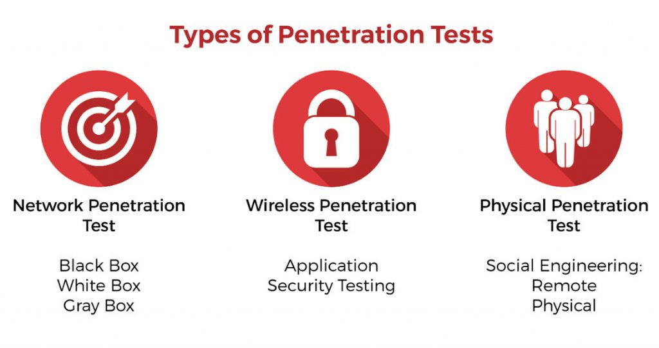

Slide 32
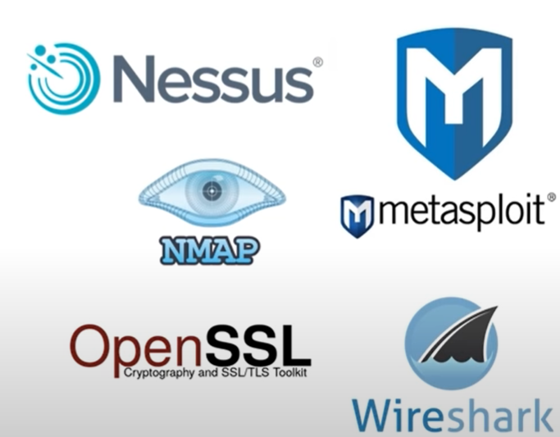
Most Useful penetration testing tools-

Slide 33
METASPLOIT UNLEASHED REQUIREMENTS
Before learning how to use the Metasploit Framework, we first need to make sure that our setup will meet or exceed the system requirements outlined in the following sections. Taking the time to properly prepare your Metasploit Lab Environment will help eliminate many problems before they arise later in the course. We highly recommend using a system that is capable of running multiple virtual machines to host your labs.
METASPLOIT UNLEASHED HARDWARE REQUIREMENTS
https://www.offensive-security.com/metasploit-unleashed/requirements/
METASPLOIT UNLEASHED SOFTWARE REQUIREMENTS
HYPERVISOR
KALI LINUX
METASPLOITABLE

Slide 34
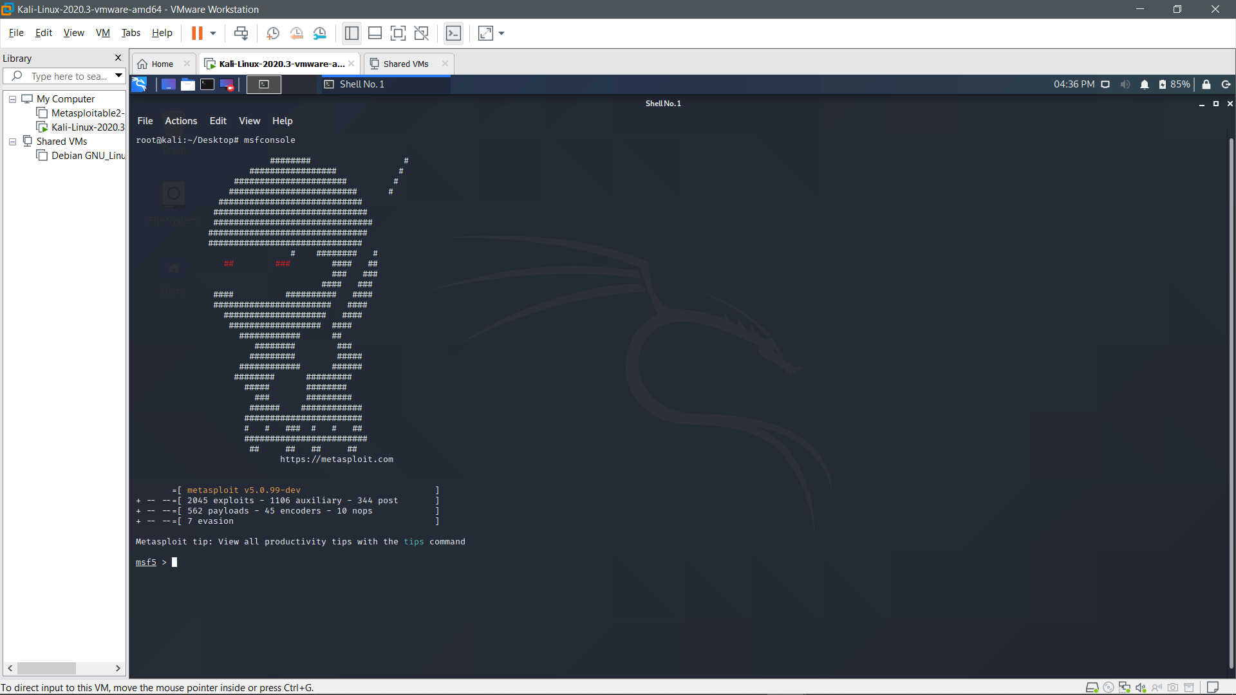

Slide 35
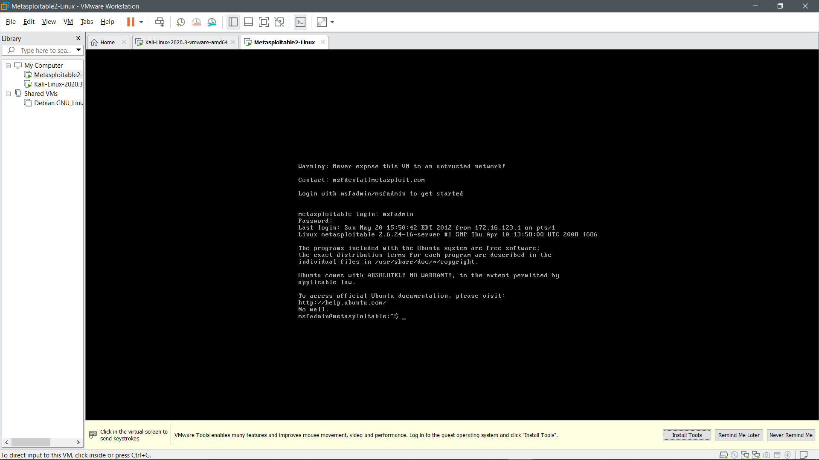

Slide 36
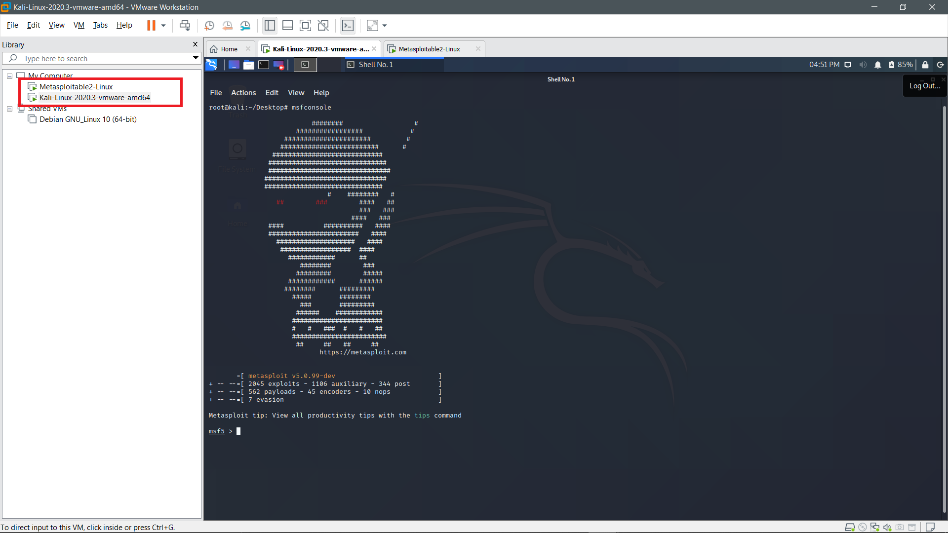

Slide 37
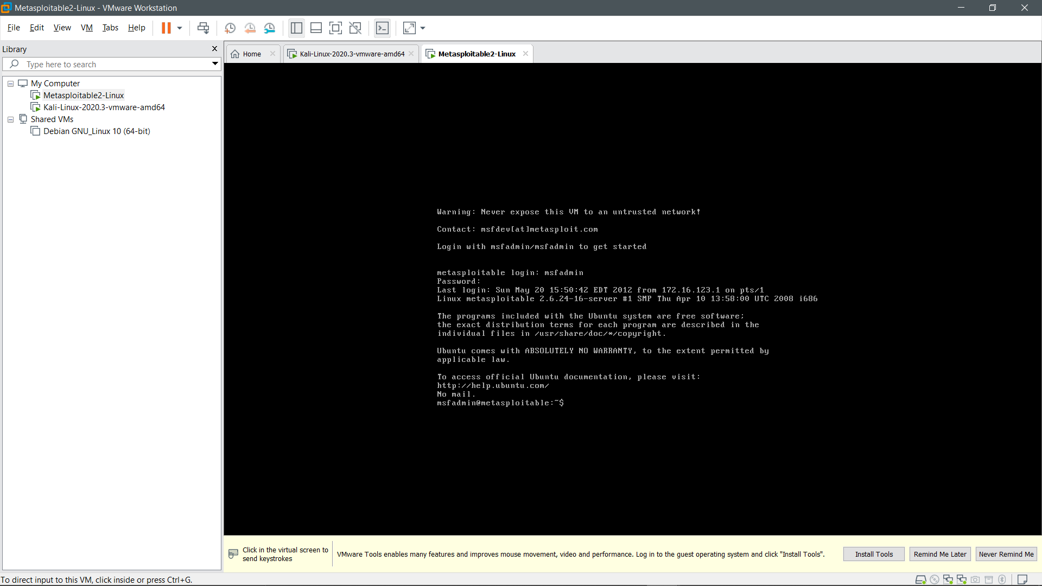

Slide 38
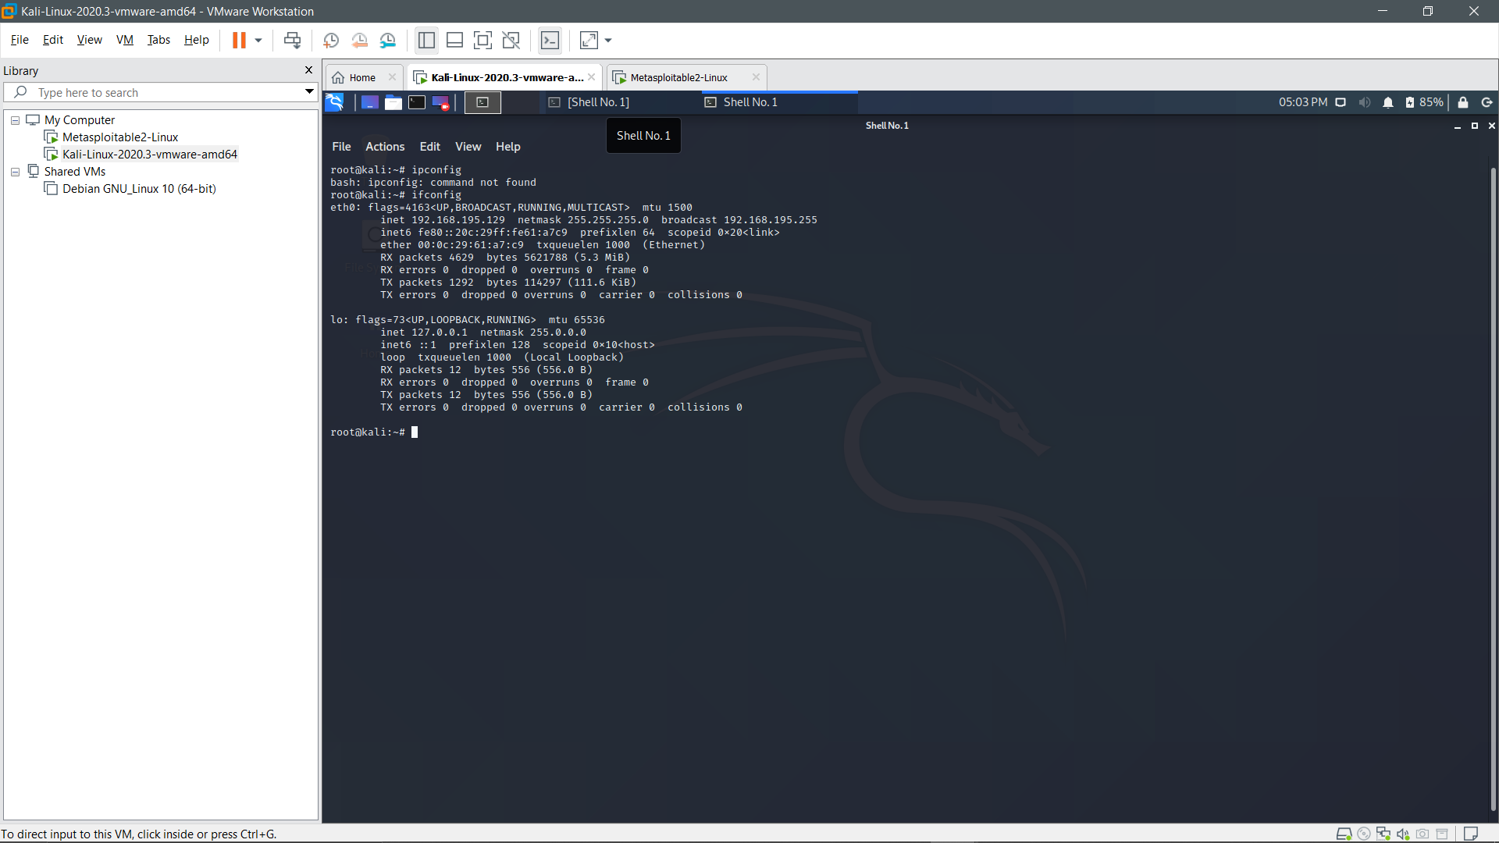

Slide 39
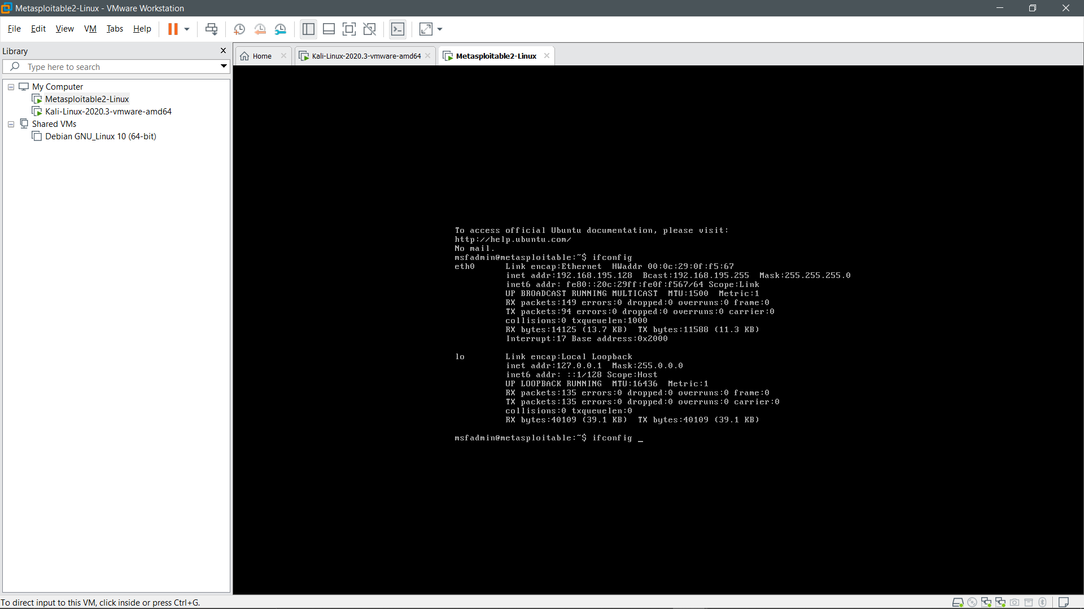

Slide 40
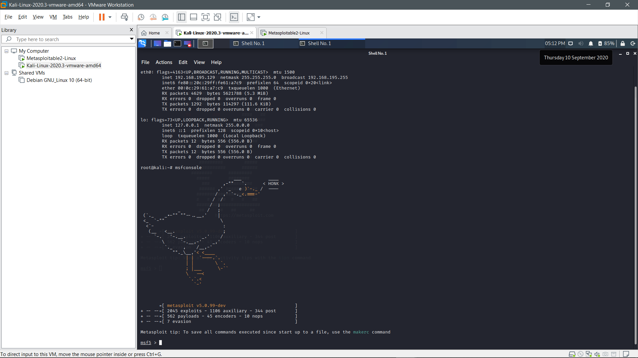

Slide 41
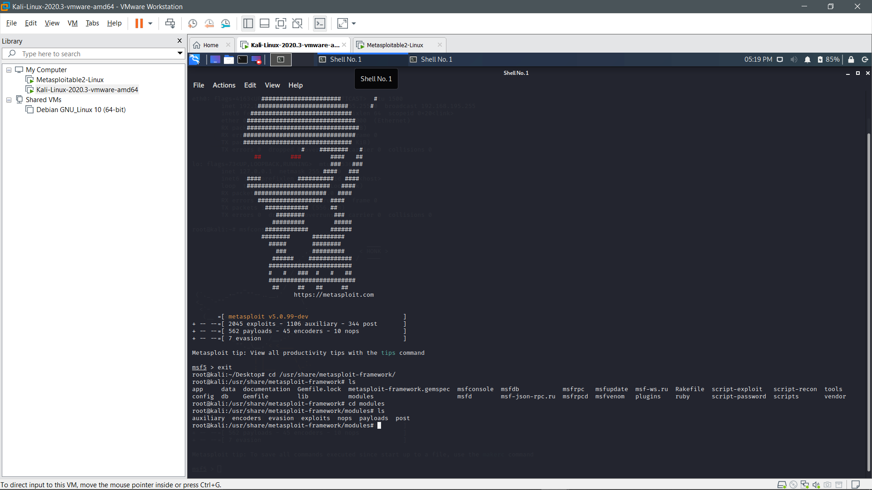

Slide 42
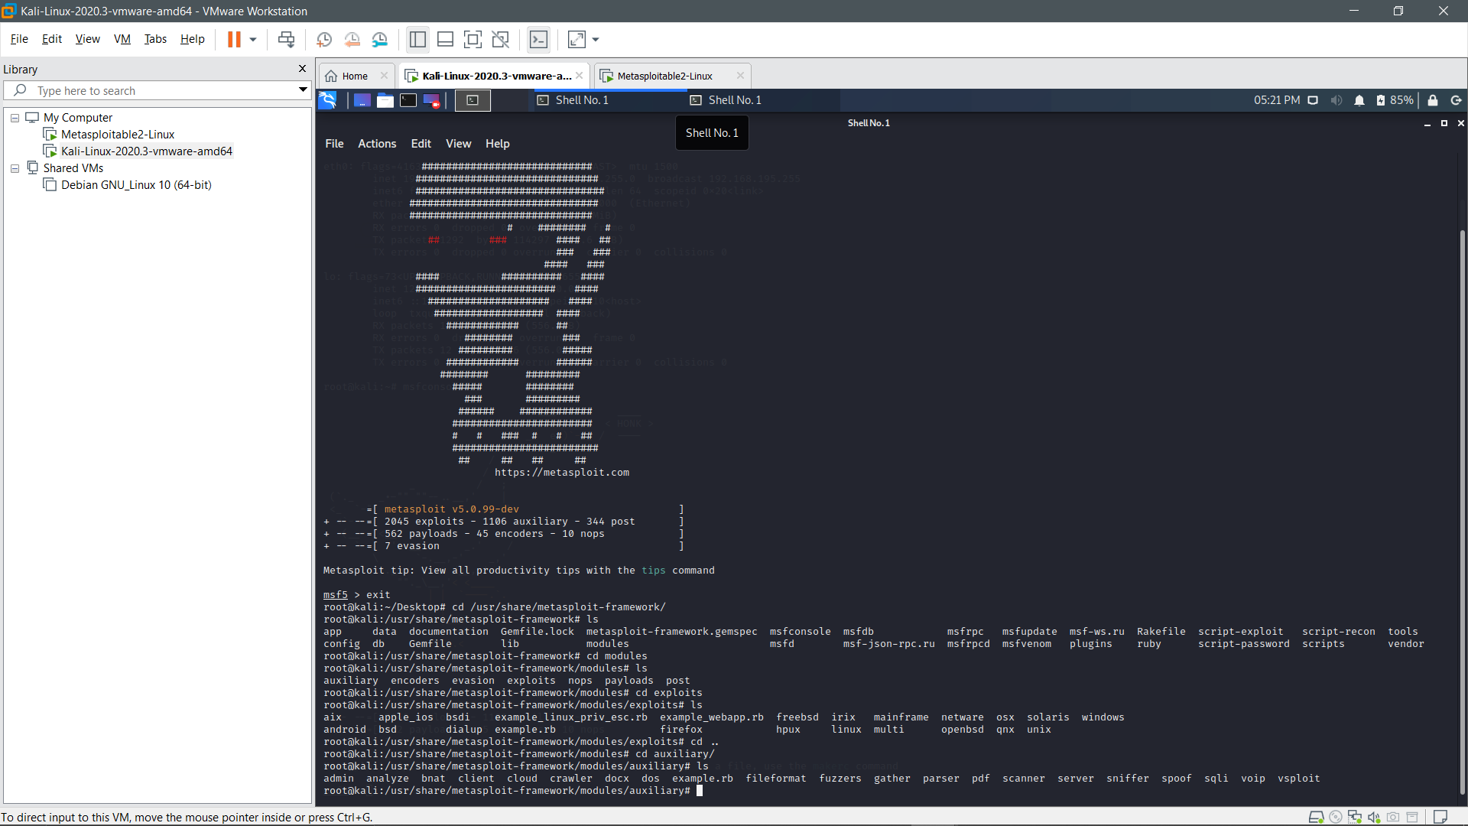

Slide 43
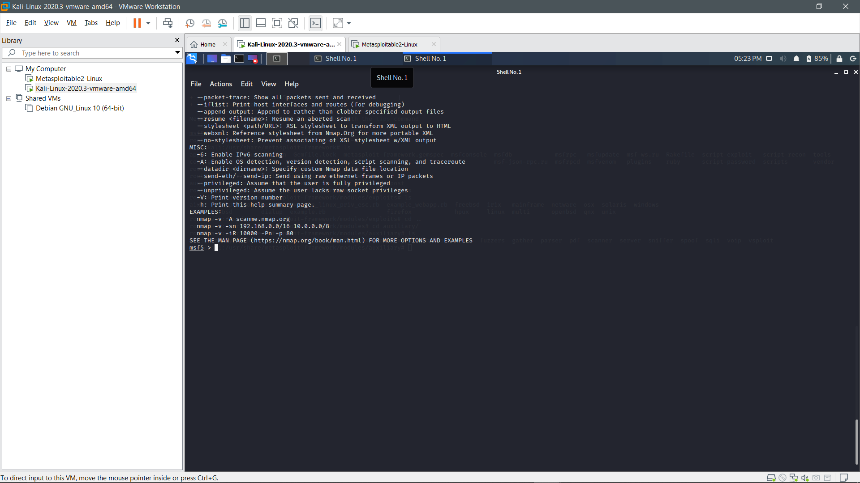

Slide 44
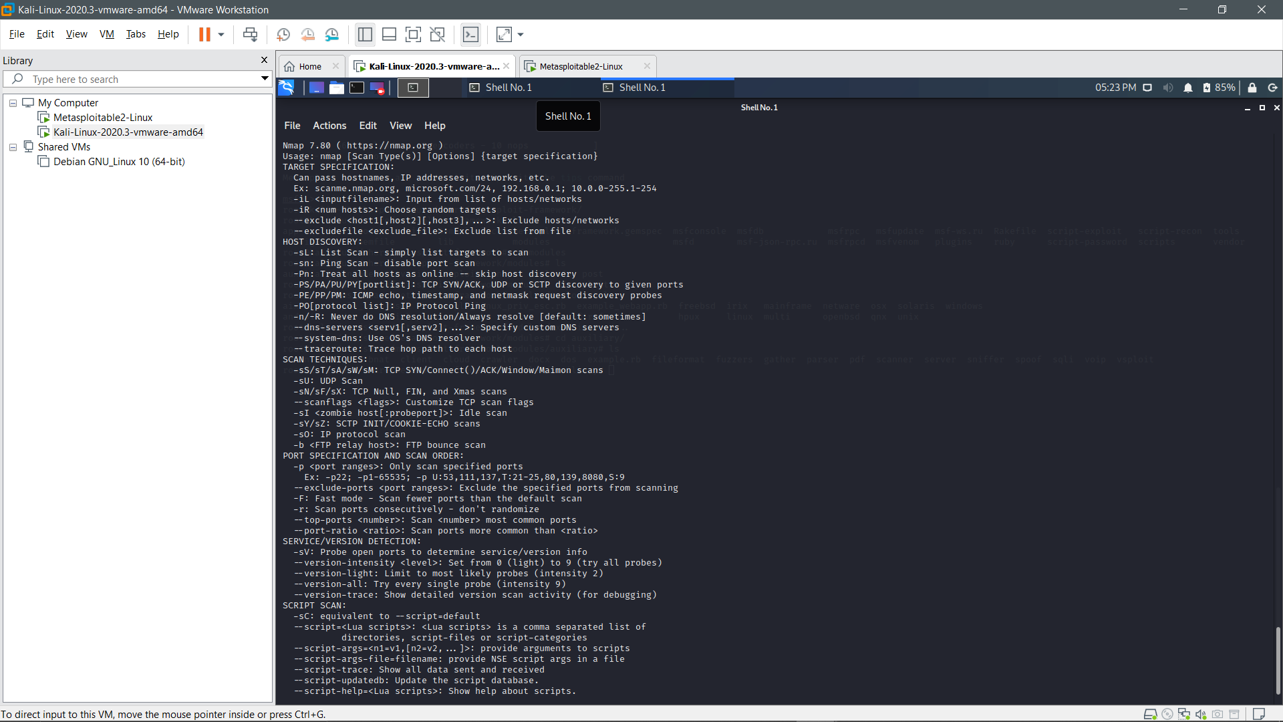

Slide 45
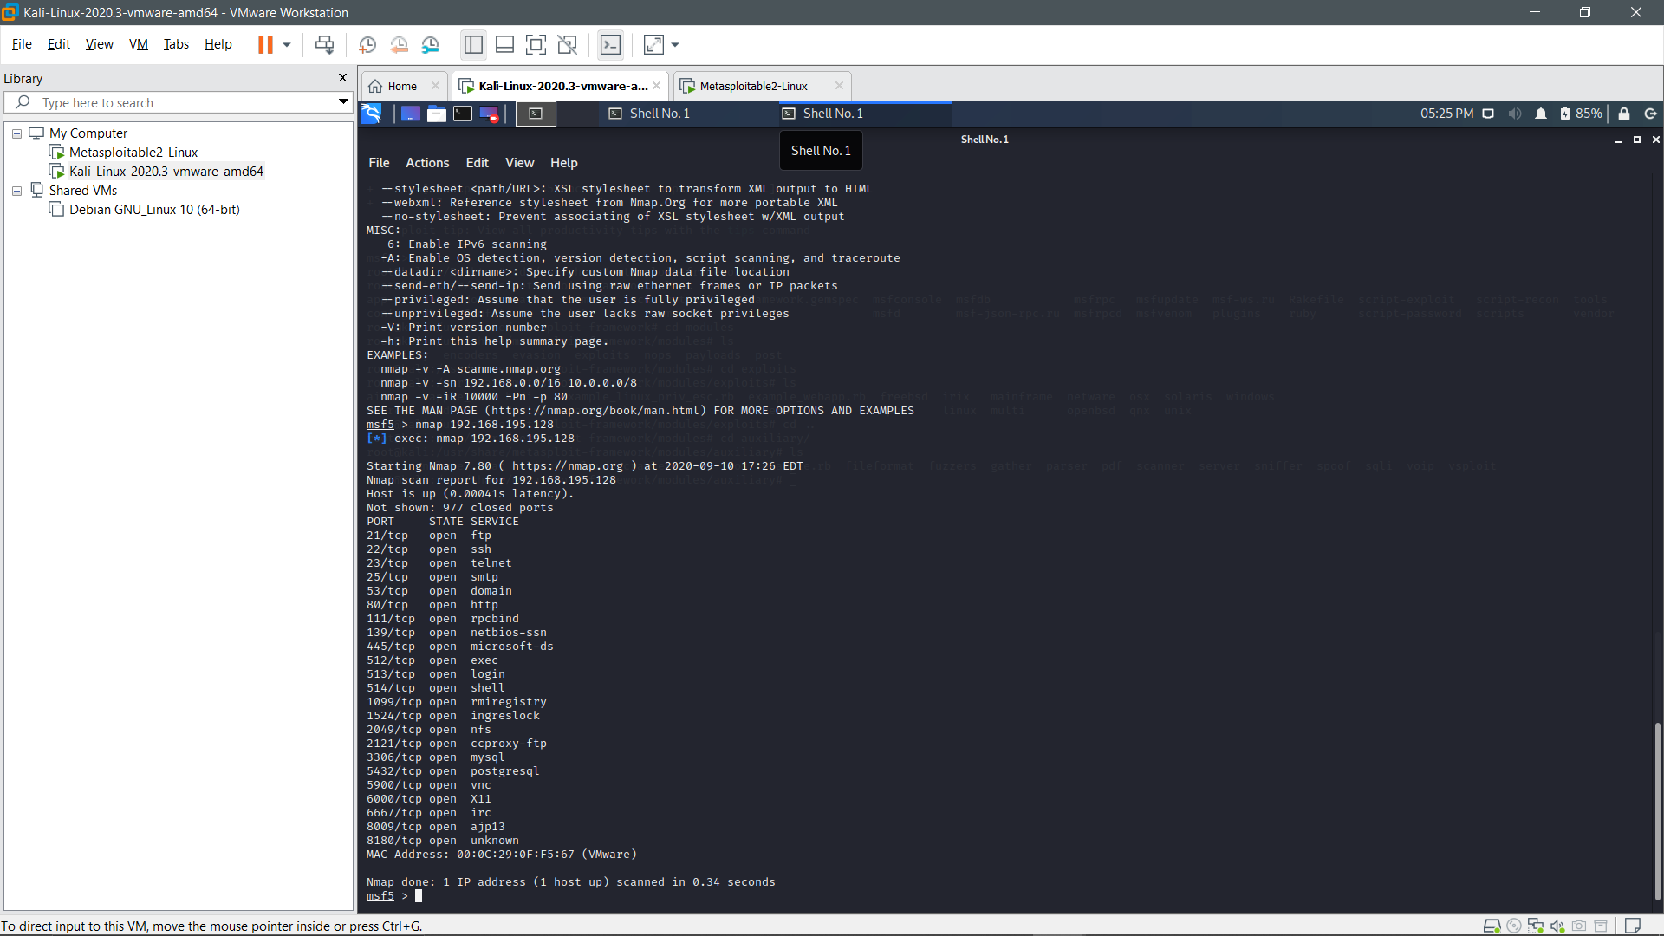

Slide 46
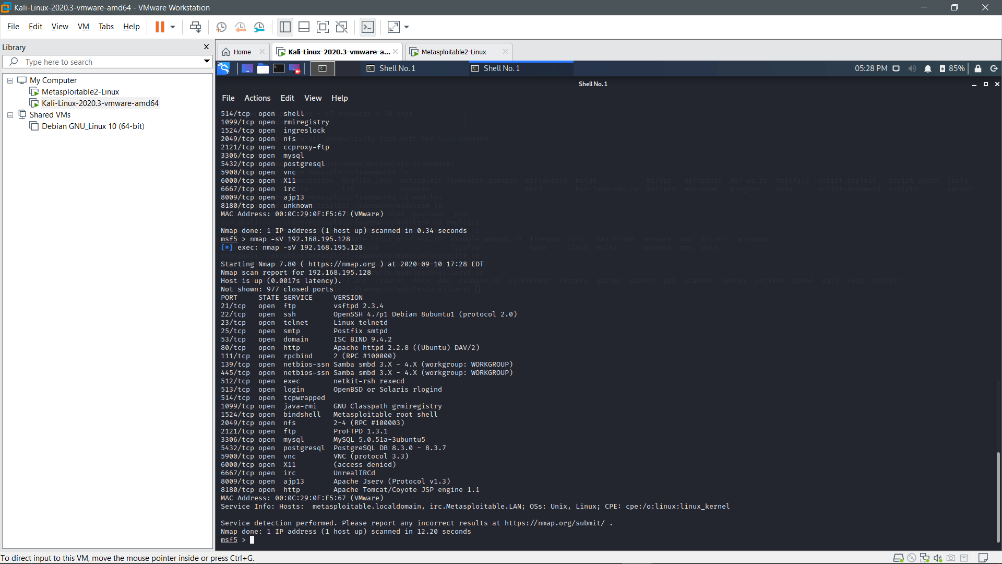

Slide 47
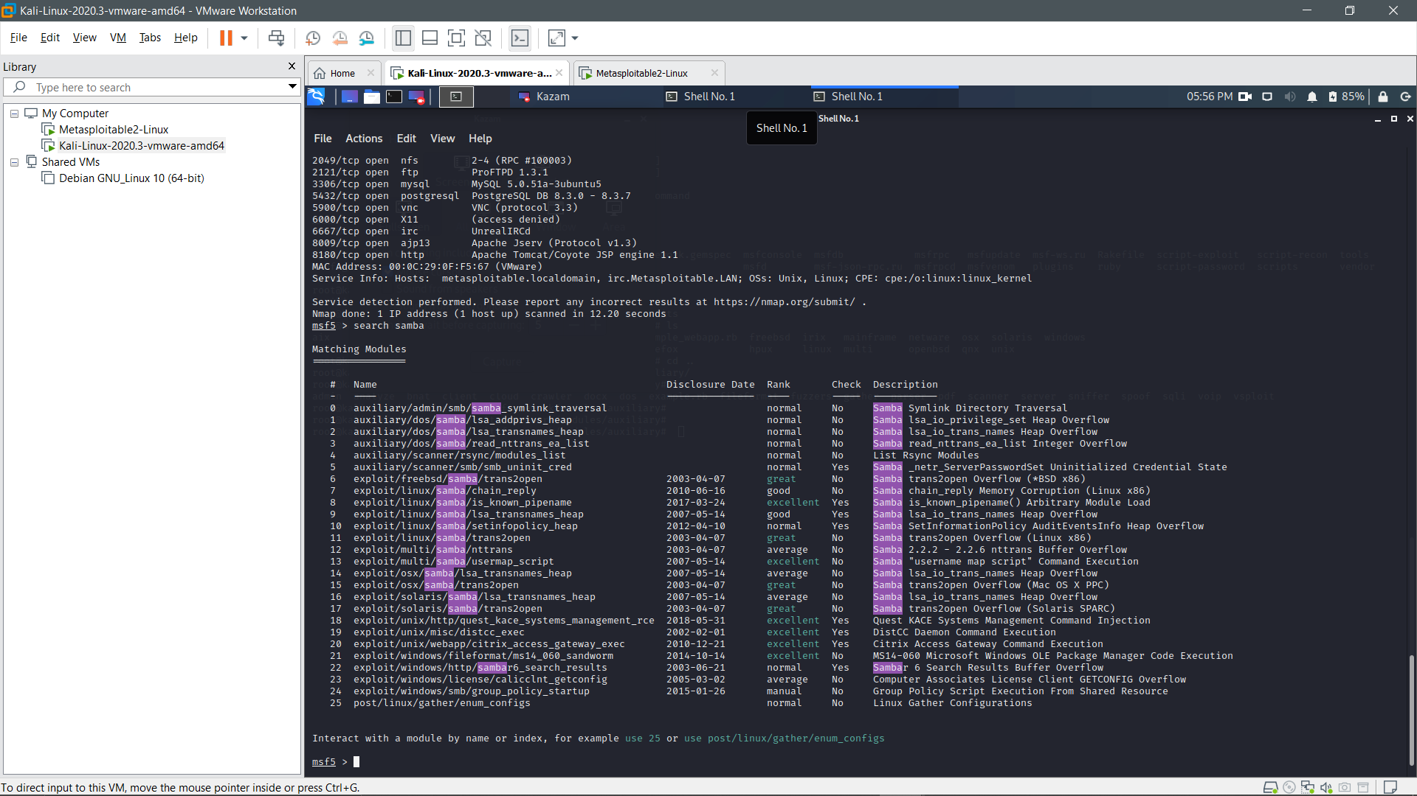

Slide 48
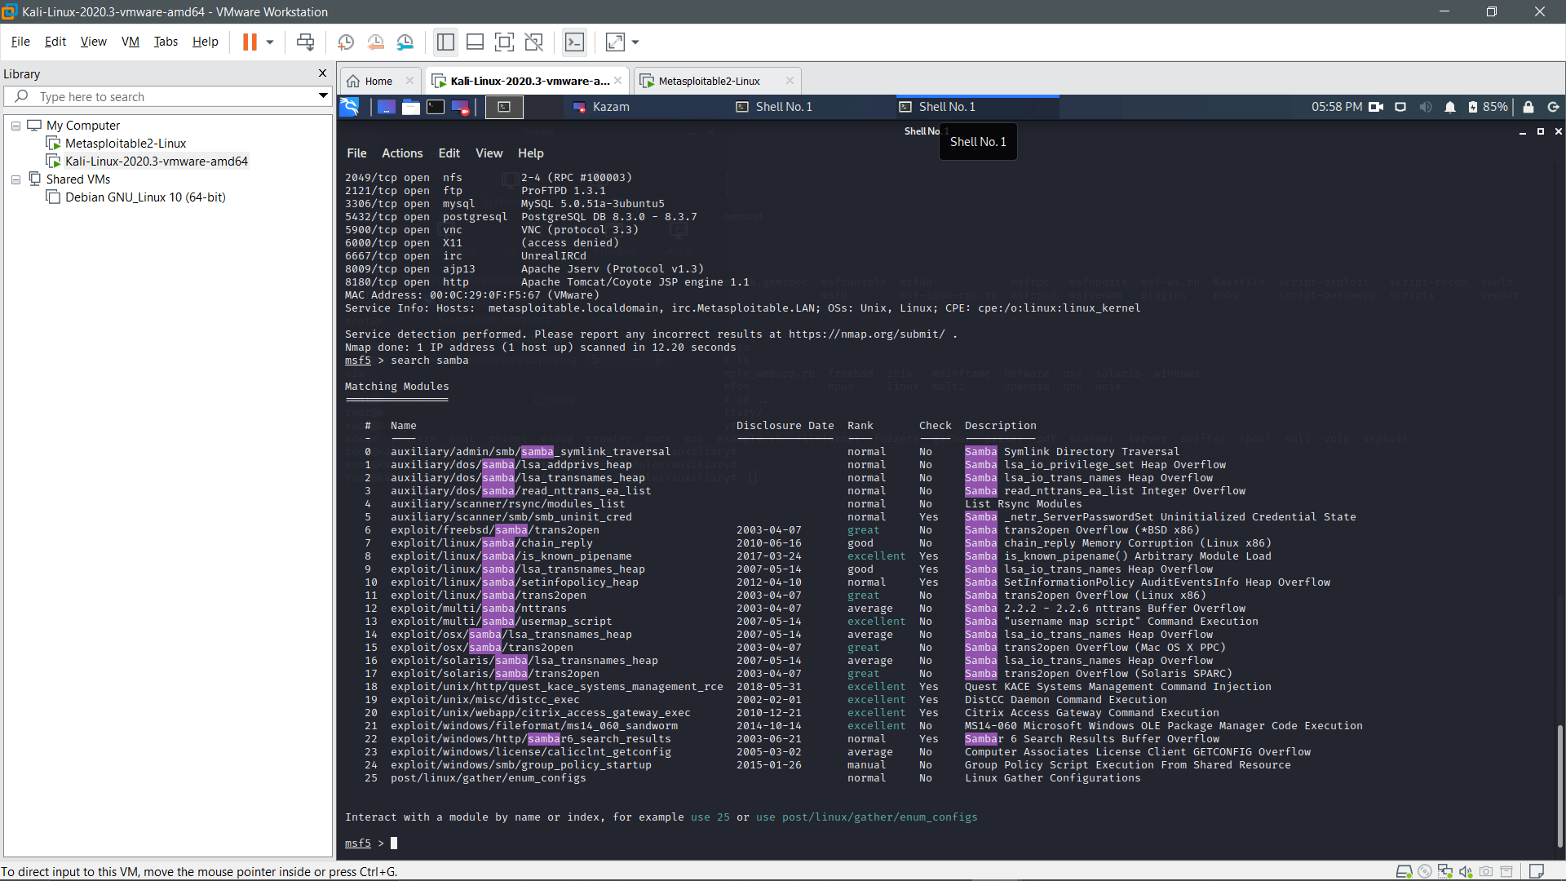

Slide 49
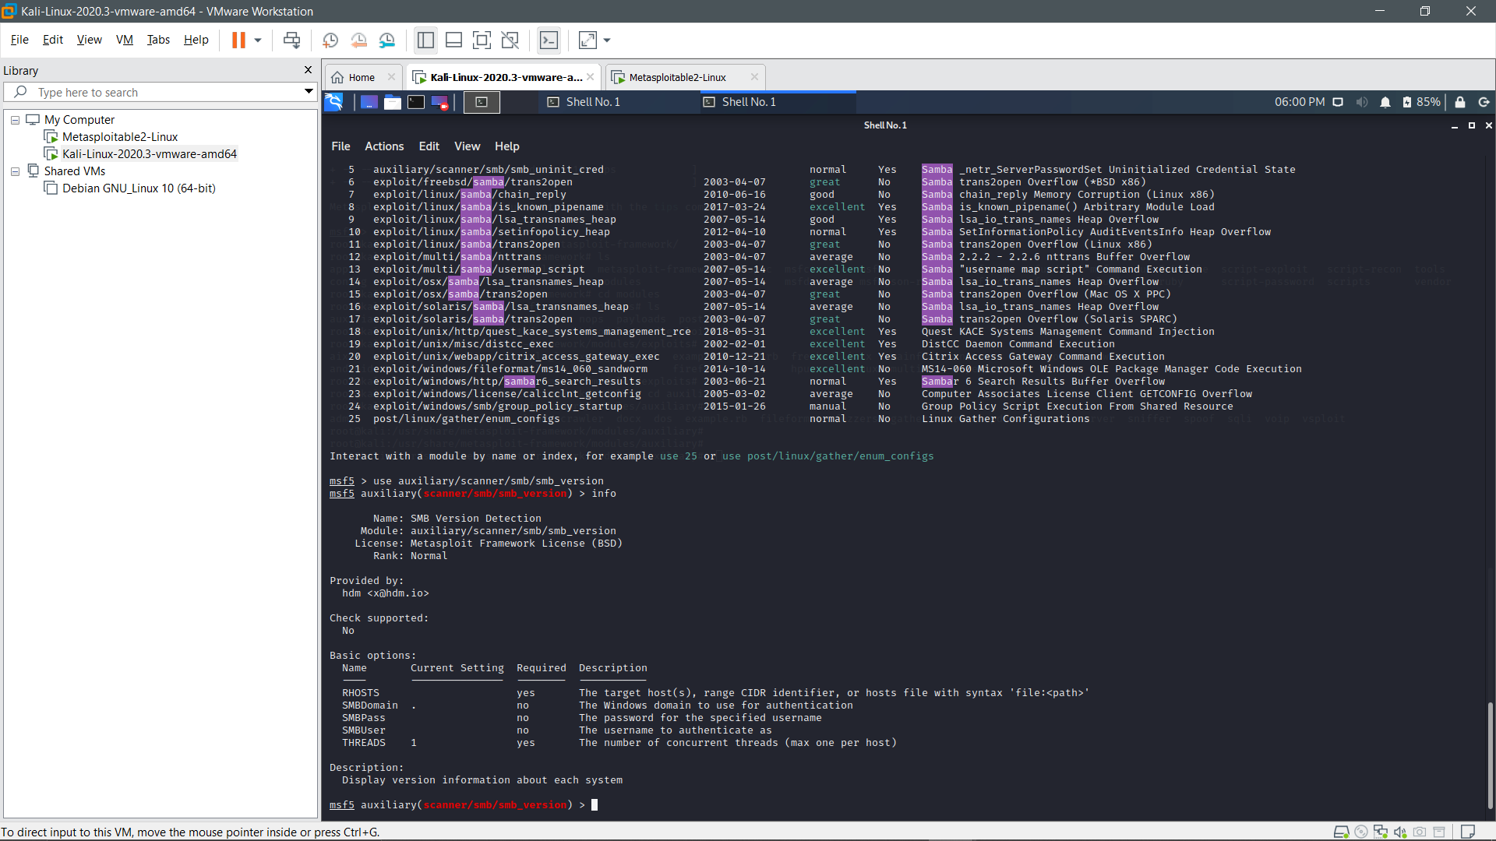
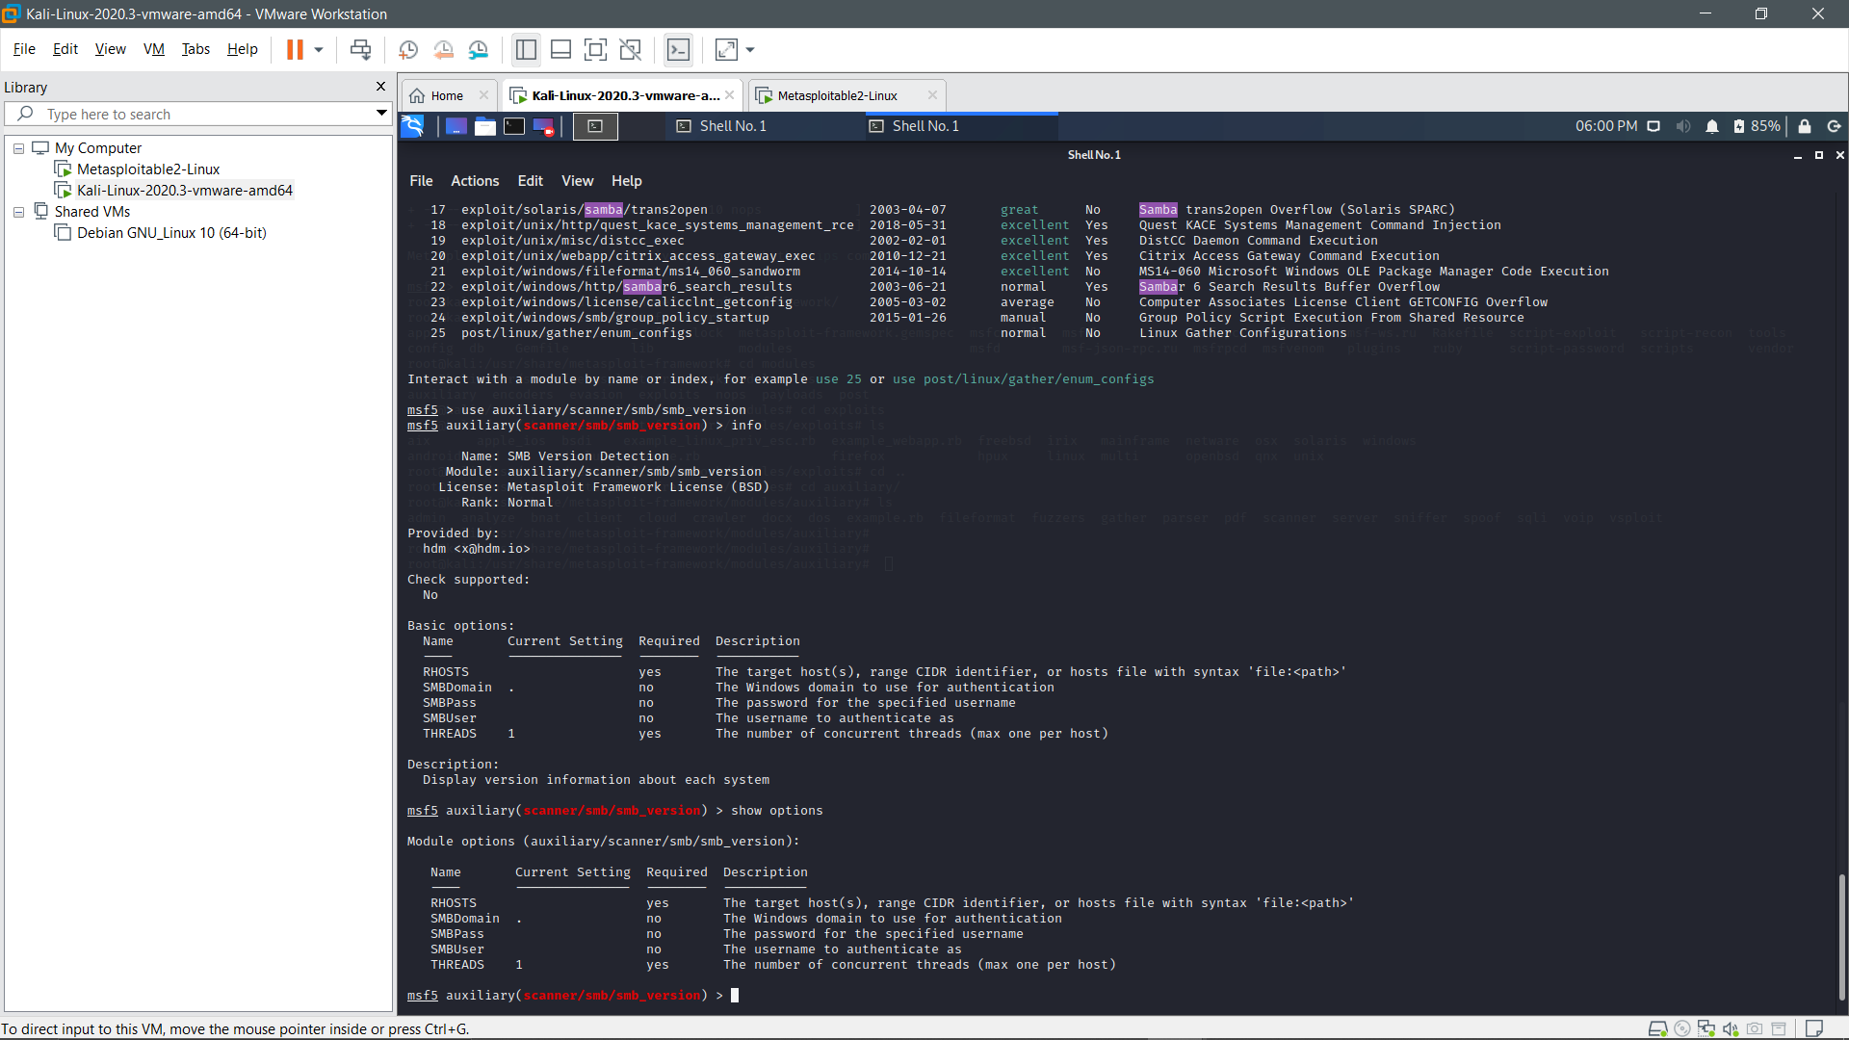

Slide 50
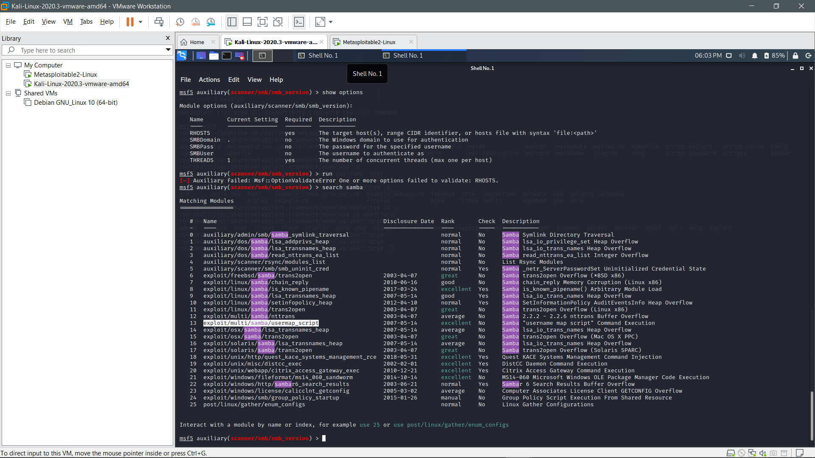
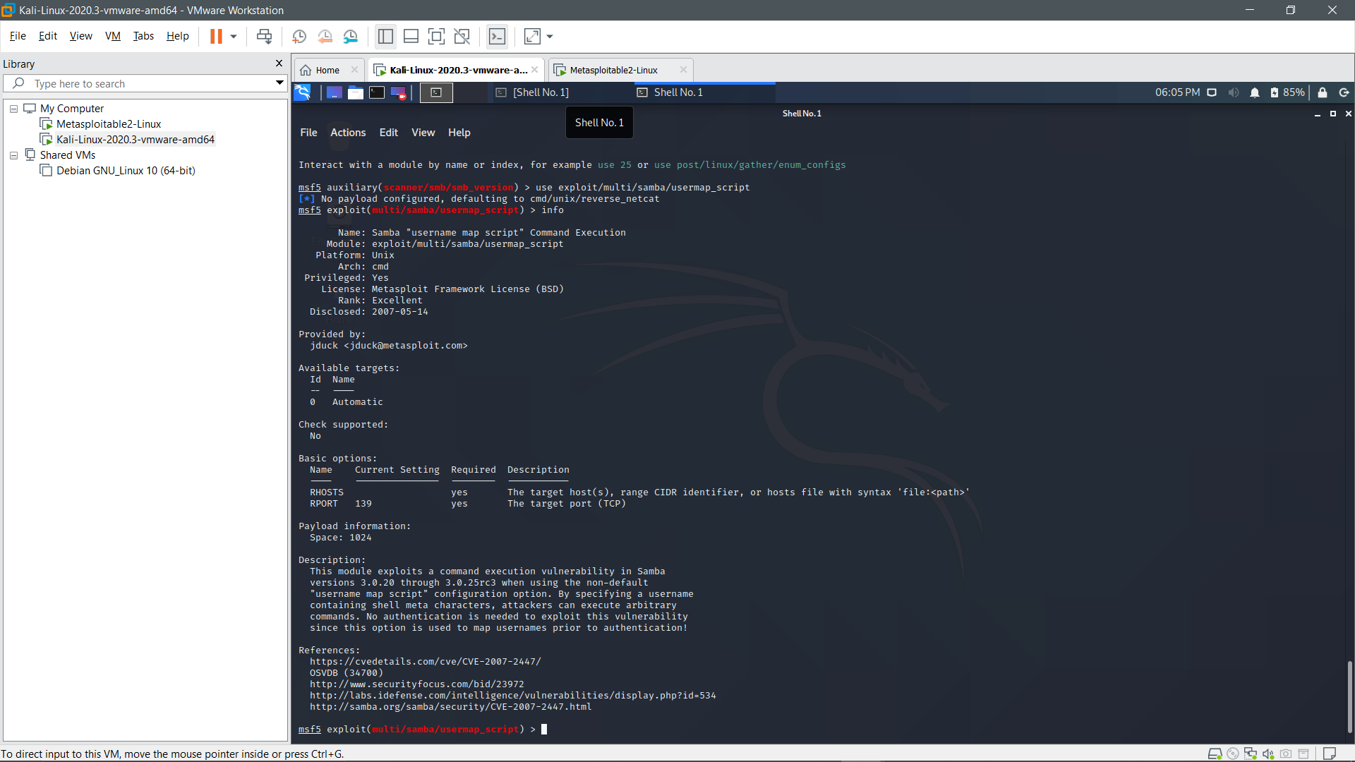

Slide 51
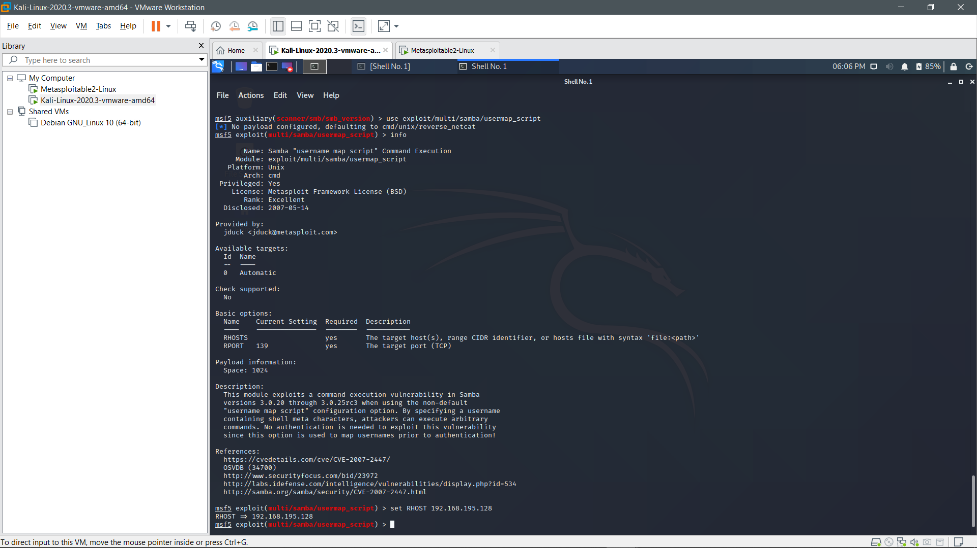

Slide 52
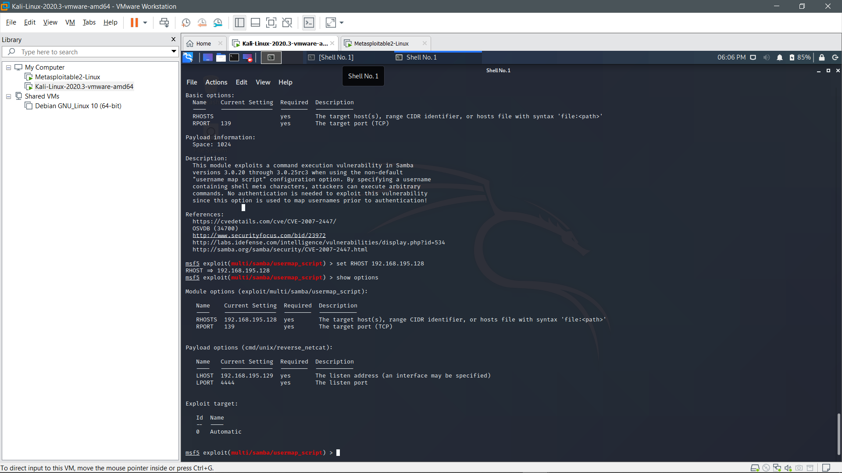

Slide 53
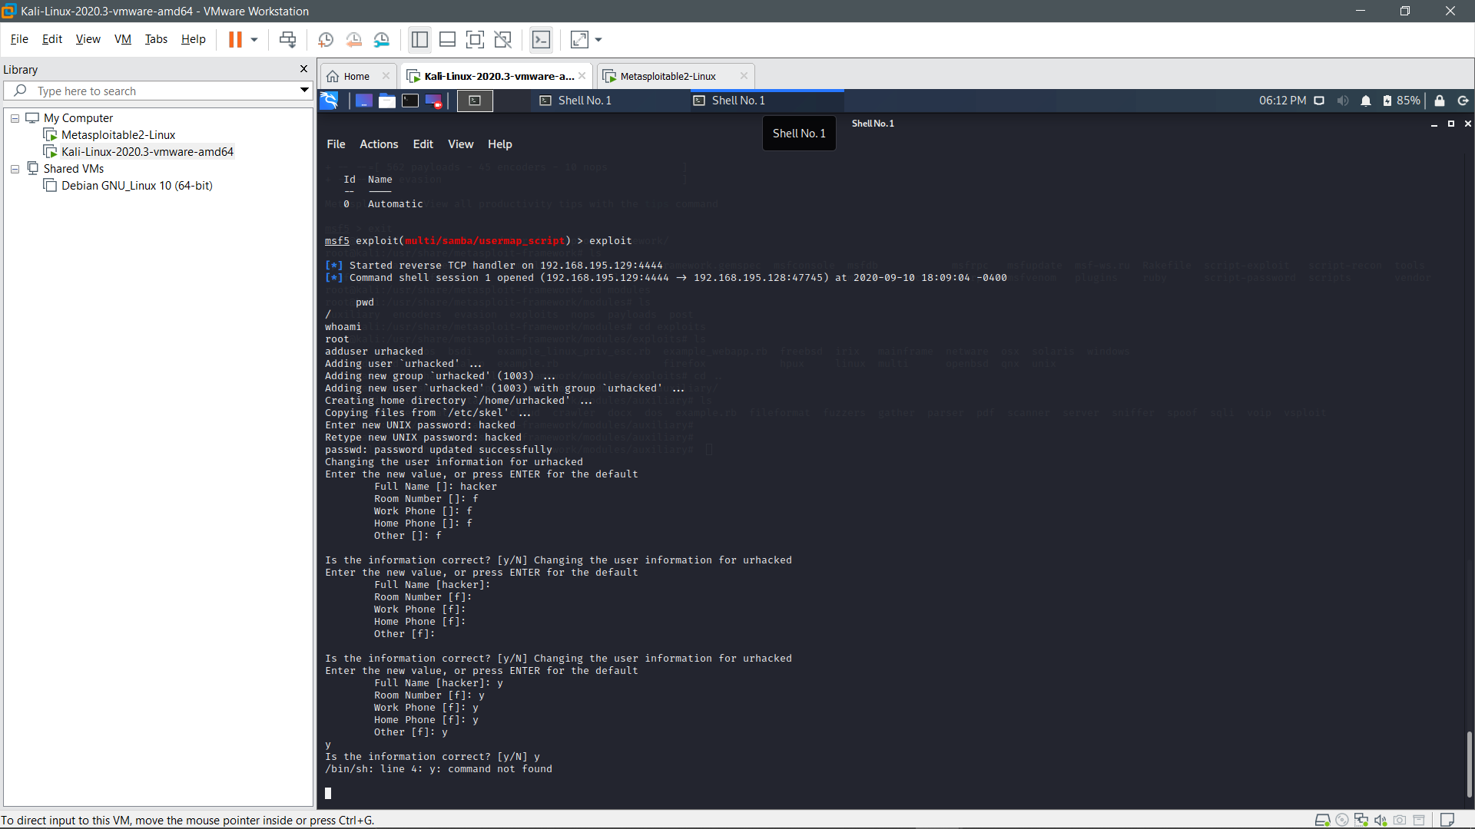
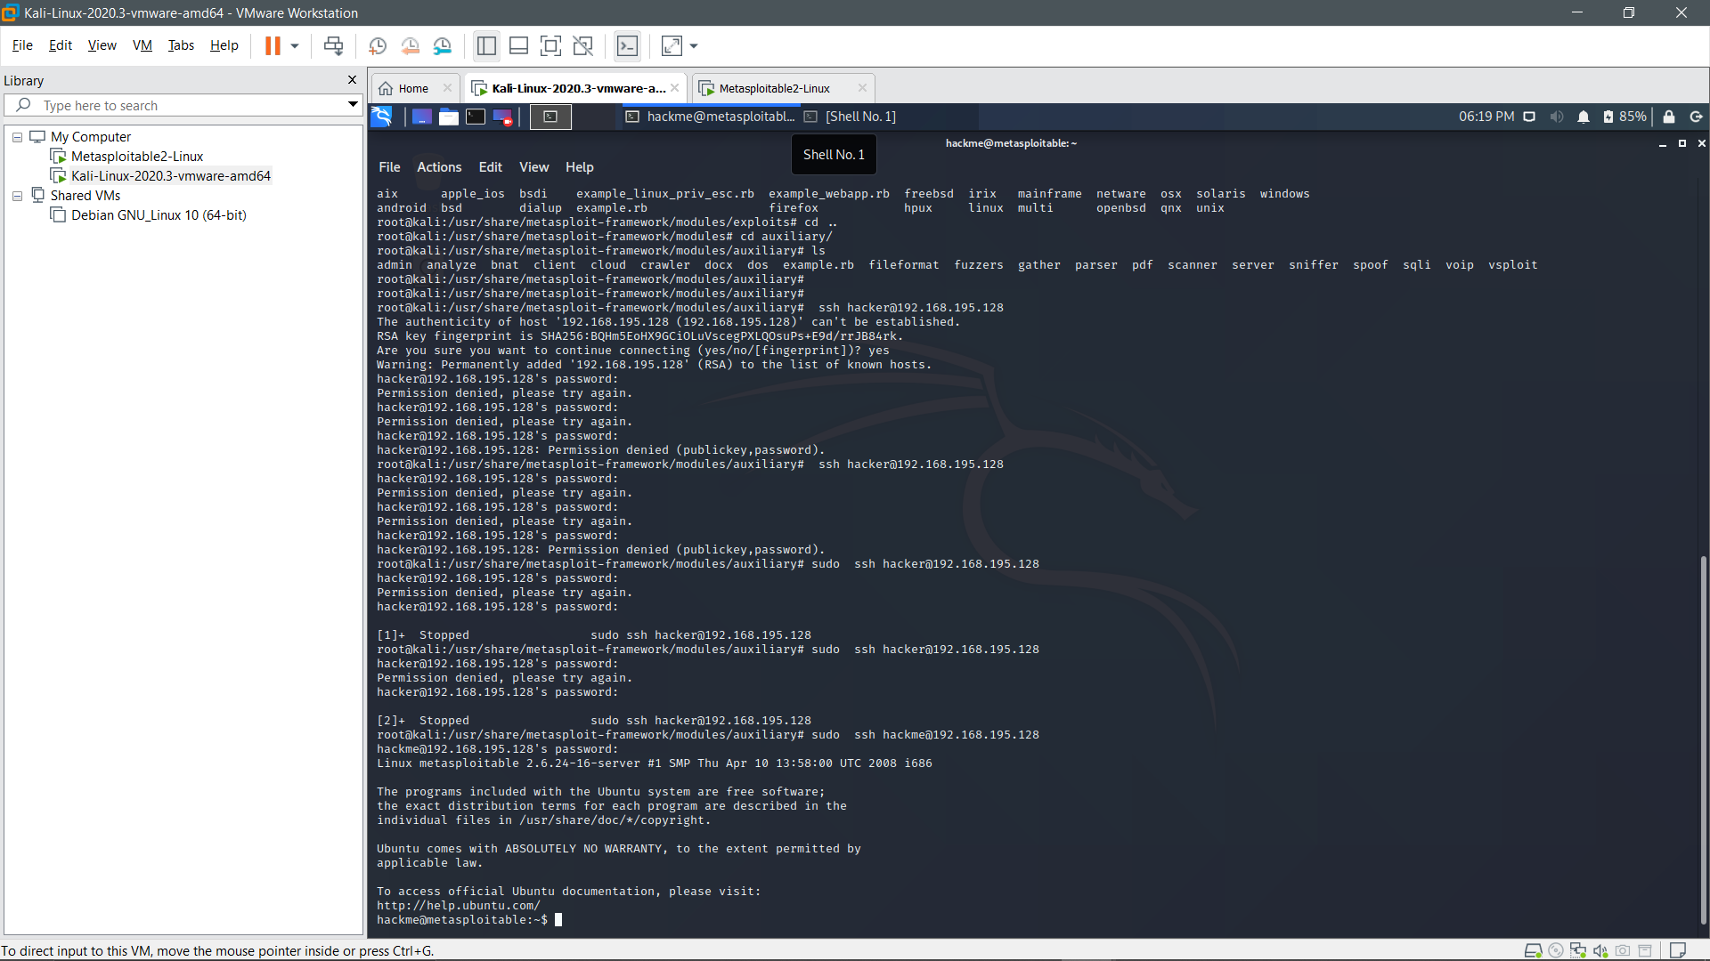

Slide 54
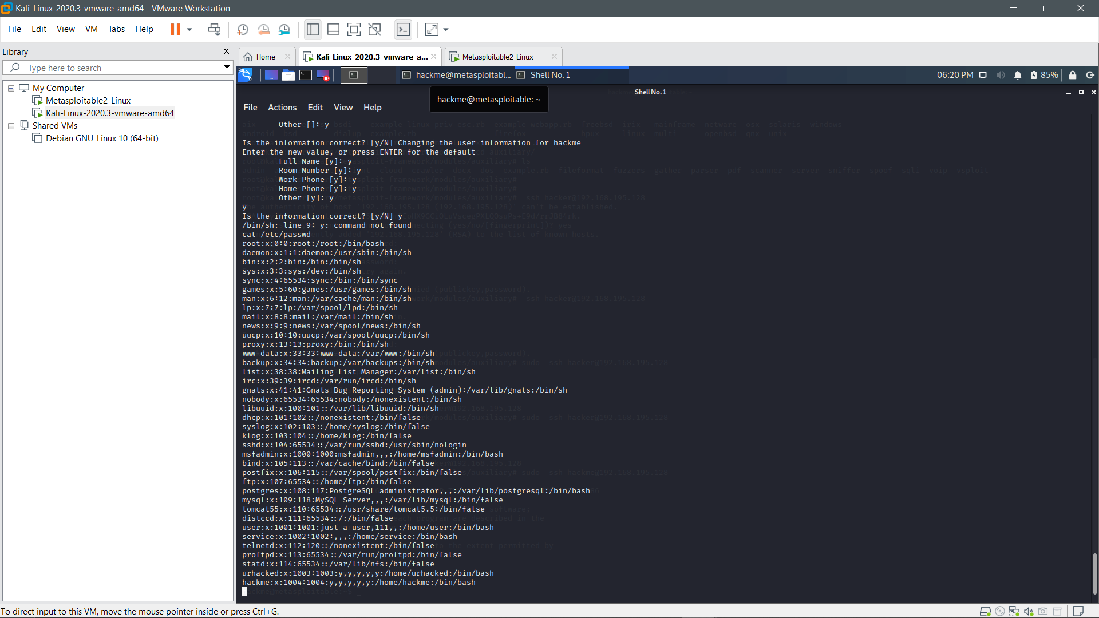

Slide 56
THANK YOU!!!!

